Slide 1
System analysis of the Interleukin-21 signaling in CD4+ T cells
Jan 7, 2014

Slide 2
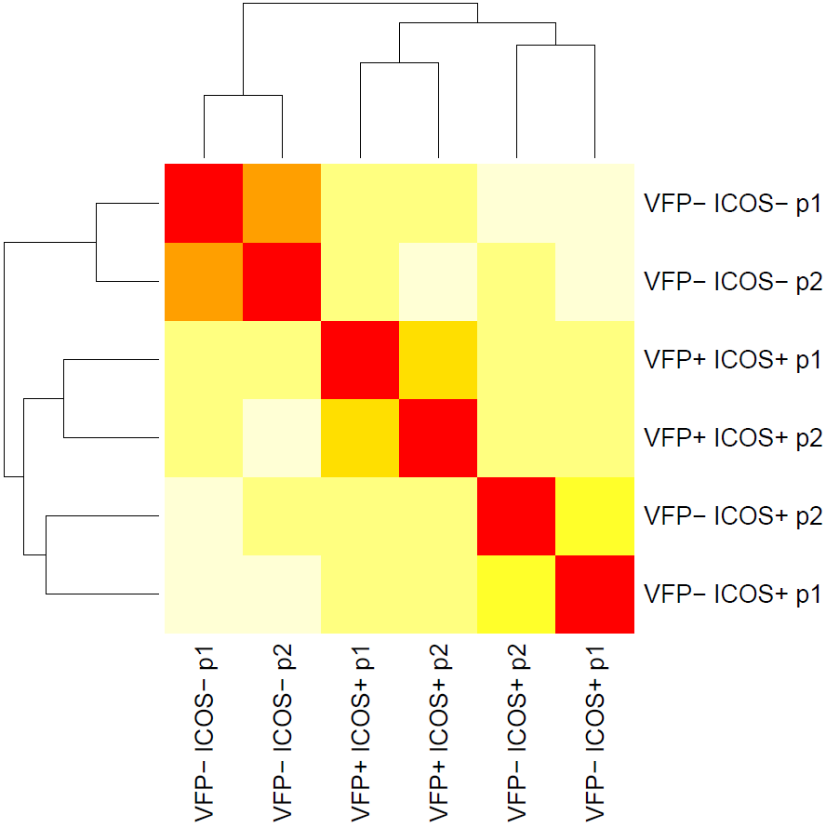
Expression profiles and significant genes
Quality control
RSEM (GRCm38)
EBSeq
Approximately 80% of reads kept for downstream analysis
Align reads to reference transcriptome
Call read counts for transcripts
Call significant genes and isoforms
VFP-ICOS-
IL21-VFP negative, ICOS negative, p1/p2
VFP+ICOS+
IL21-VFP positive, ICOS positive, p1/p2
VFP-ICOS+
IL21-VFP negative, ICOS positive, p1/p2
R: Heat map plot Euclidean distances between samples
./rsem/

Slide 3
VFP and Il21 transcripts

Slide 4
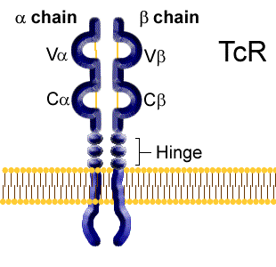
T cell receptor repertoire
V – 132
D – 2
J - 73
C
No reads

Slide 5
TCR-[alpha|beta]-V genes
55 V genes with maximal TPM larger than 5, standard deviation larger than 5

Slide 6
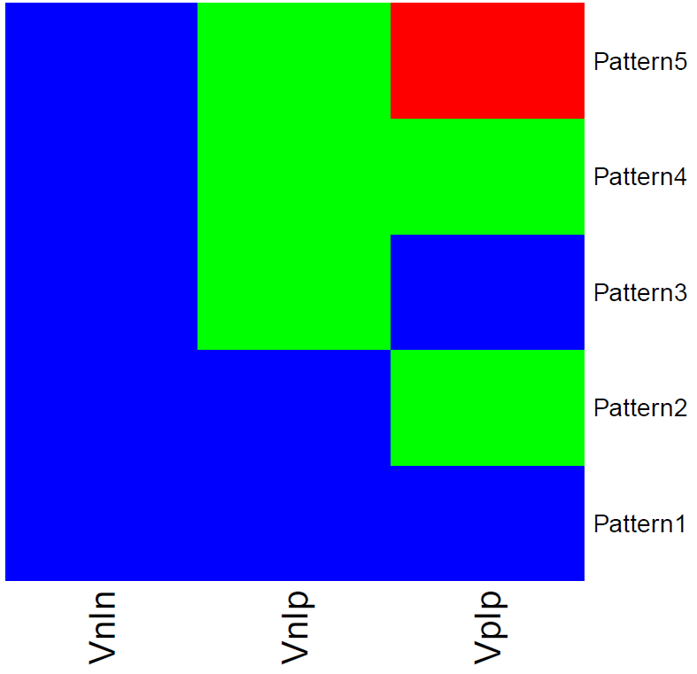
Significant genes and isoforms in each pattern
Genes | Isoforms
352 | 406
452 | 452
219 | 444
188 | 338
7658 | 19458
VFP⁻ ICOS⁻
VFP⁻ ICO⁺
VFP⁺ ICO⁺
Total of 18837 genes and 48286 isoforms examined.
./mygenelist_symbol
./Lupus_ppmeanslog2fc

Slide 7
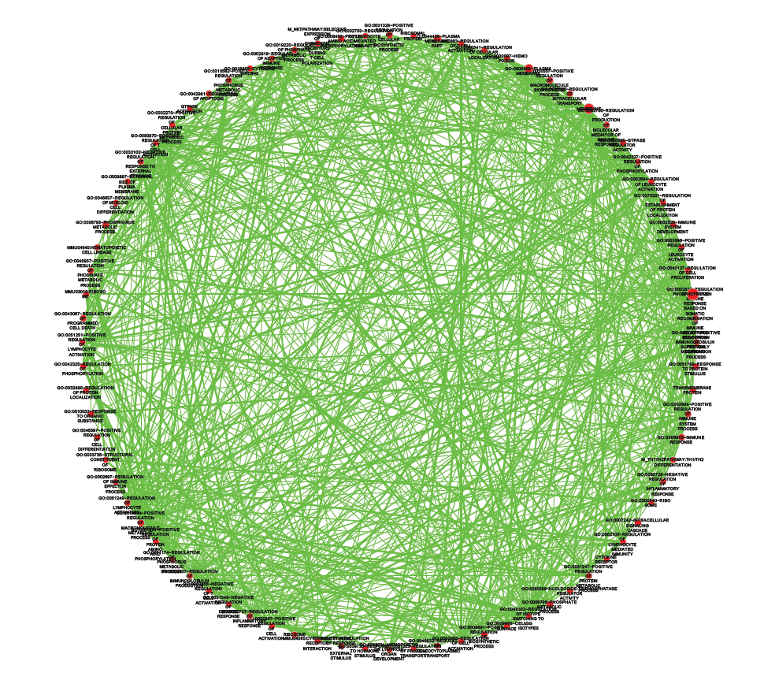
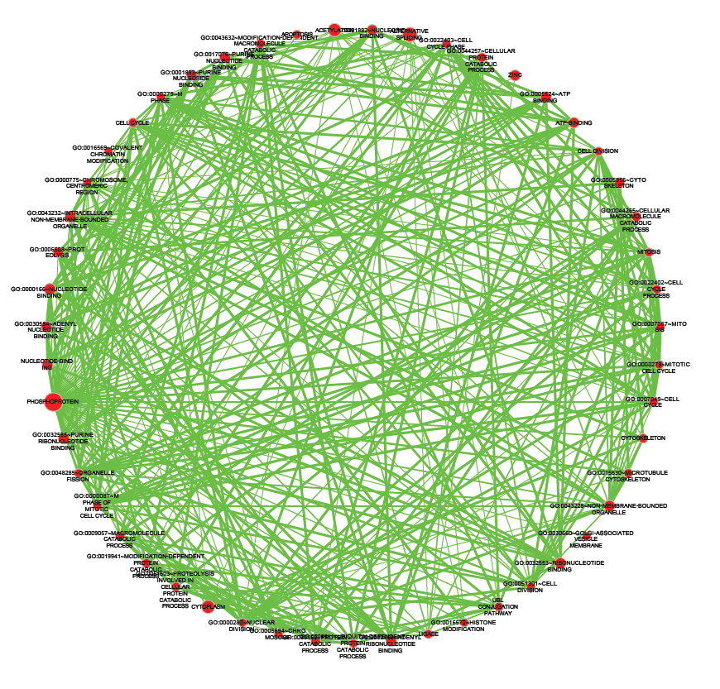
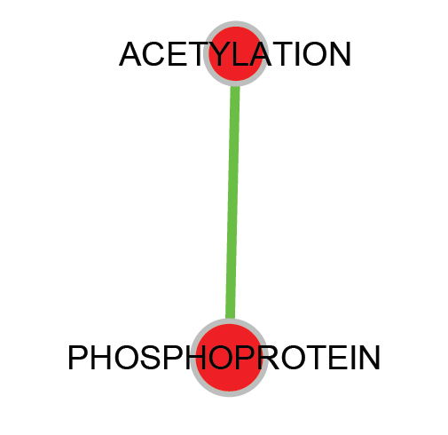
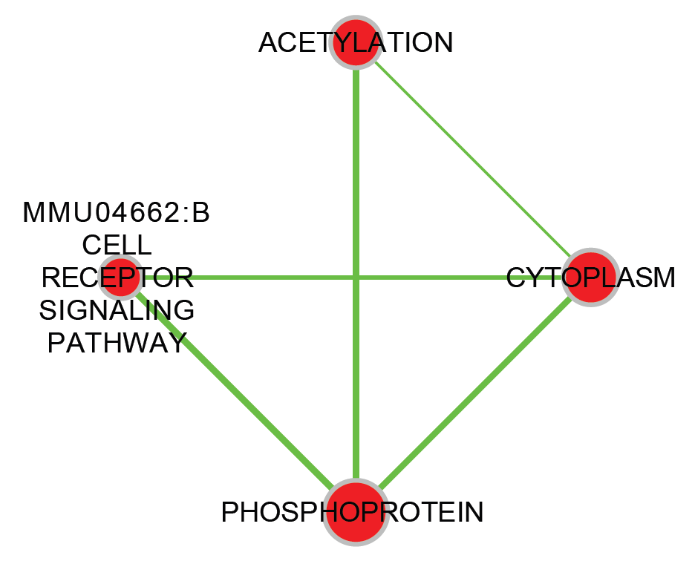
Functional Annotation Enrichment
Significant genes from EBSeq
DAVID
Cytoscape
Pattern 2
Pattern 3
Pattern 4
Pattern 5
./DAVID/
./DAVID/FunctionalAnnotationChart.xlsx
./DAVID/FunctionalAnnotationClustering.xlsx

Slide 8
Signature genes for each cell type
Il21
Maf
Cxcr5
Cd28
Ccl5
Btla
ACT IL21 vs N
Bcl6
Foxo1
Il4ra
Il2ra
N
ACT
ACT IL21
Sell
Foxp3
ACT vs N

Slide 9
Expression profiles correlation
214 Immgen datasets
3 Liu’s data
3 Lupus data (TPM)
RMA normalization
Background correction
Background correction
Intensity values of expressed genes in each datasets
TPM values of expressed genes
Signature genes from Lupus data
Correlation and PCA

Slide 10
Expression profiles correlation
Liu
NK Cells
Neutrophils
Monocytes
Stem Cells
B Cells
Dendritic Cells
Macrophages
NK Cells
αβ T Cells
γδ T Cells
Stromal Cells
./Corr/

Slide 11
Expression profiles correlation
VFP-ICOS-
VFP-ICOS+
VFP+ICOS+
./Corr/

Slide 12
PCA clustering of top correlated samples

Slide 13
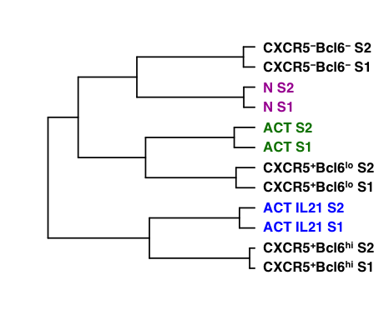
Two way hierarchical clustering with Liu et al.
CXCR5⁻Bcl6⁻ S2
CXCR5⁻Bcl6⁻ S1
N S2
N S1
ACT S2
ACT S1
CXCR5⁺Bcl6^{lo} S2
CXCR5⁺Bcl6^{lo} S1
ACT IL21 S2
ACT IL21 S1
CXCR5⁺Bcl6^{hi} S2
CXCR5⁺Bcl6^{hi} S1

Slide 14
Terhost et al., 2013 genes
*5
*5
*4
*5

Slide 15
Some genes
*5
*5
*4
*3
P2 for Bcl6 = 0.9479

Slide 16
Significant genes in double positive sample
Pattern 2
Genes in Pattern 2 that are also 1 times higher in +/+ than either of the other 2 groups. The max read counts larger than 100.

Slide 17
Significant genes in double positive sample
Pattern 2
Genes in Pattern 2 that are also 1 times less in +/+ than either of the other 2 groups. The max read counts larger than 100.

Slide 18
Significant genes in double positive sample
Pattern 5
Genes in Pattern 5 that are also 1 times high in +/+ than both of the other 2 groups. The max read counts larger than 100.

Slide 19
Significant genes in double positive sample
Pattern 5
Genes in Pattern 5 that are also 1 times less in +/+ than both of the other 2 groups. The max read counts larger than 100.

Slide 20
The 1675 Transcriptional factors
2 times higher or ½ times less expression in double positive than the other 2 groups. The max read counts larger than 20.

Slide 21
Top regulated genes in double positive sample
4 times higher or ¼ times less expression in double positive than both the other 2 groups. The max read counts larger than 100.

Slide 22
KEGG pathway 1: T cell receptor signaling

Slide 23
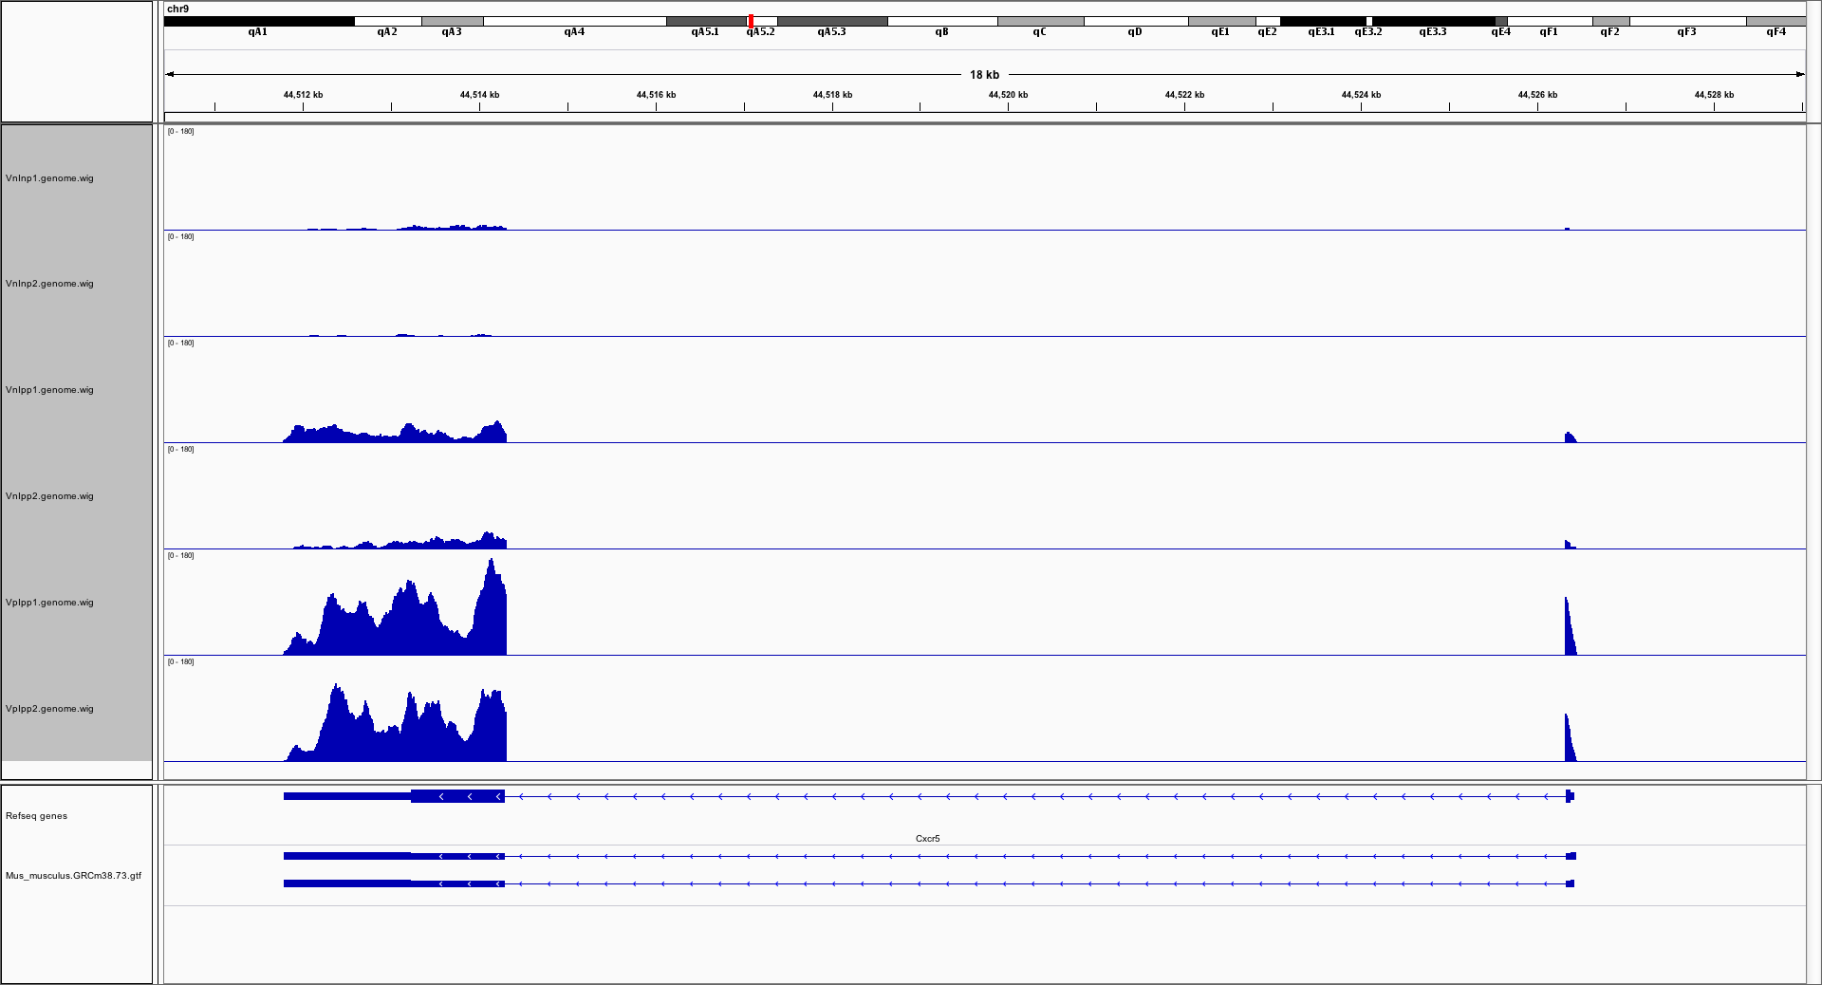
Cxcr5 – alignment details

Slide 24
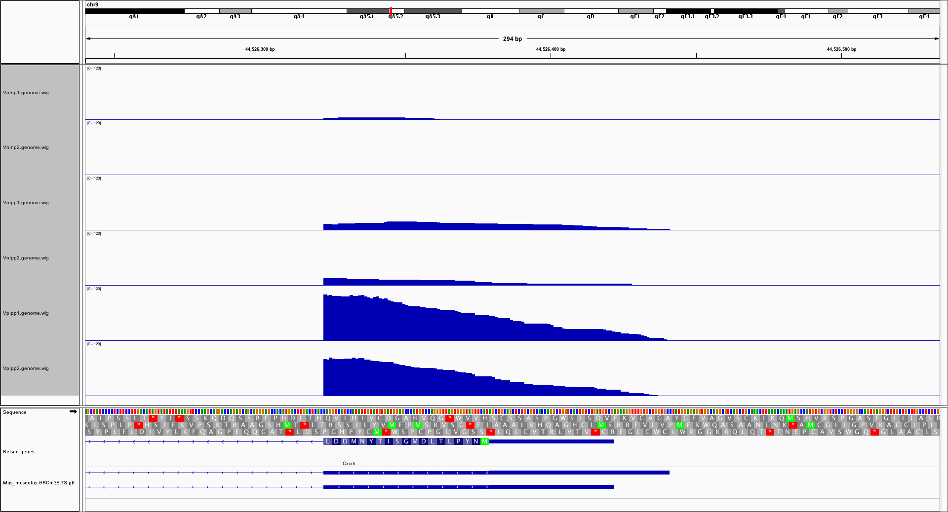
Cxcr5 – alignment details

Slide 25
Cxcr5 – assigned read counts for isoforms

Slide 26
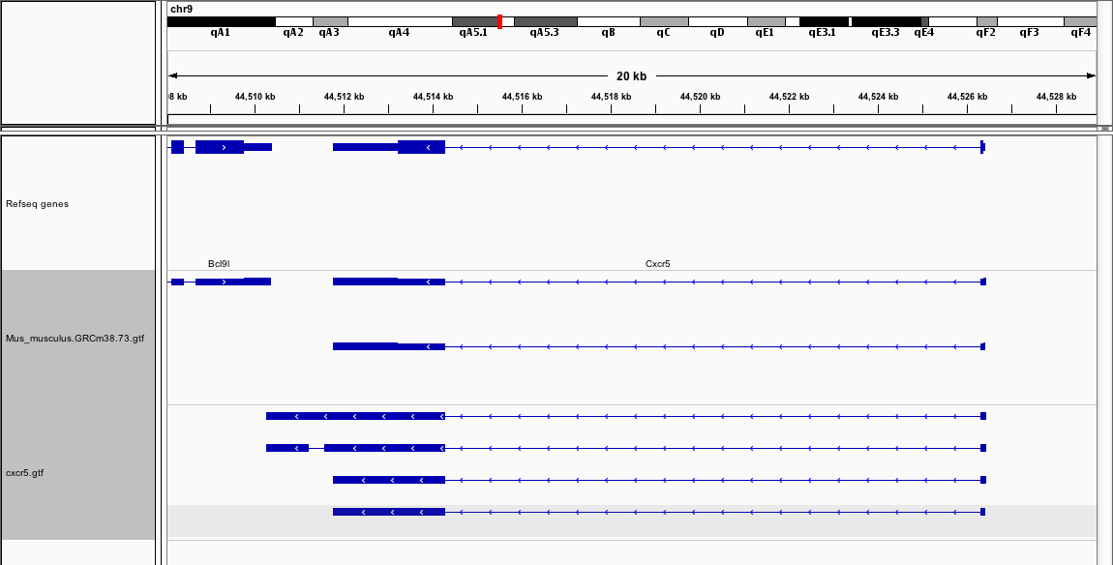
Cxcr5 – from cufflinks
Cufflinks defined 4 isoforms, which can be correlated with the 2 official ensembl isoforms based on the 3’ features
Cufflinks isoforms 1-3 are defined by their 5’ variations

Slide 27
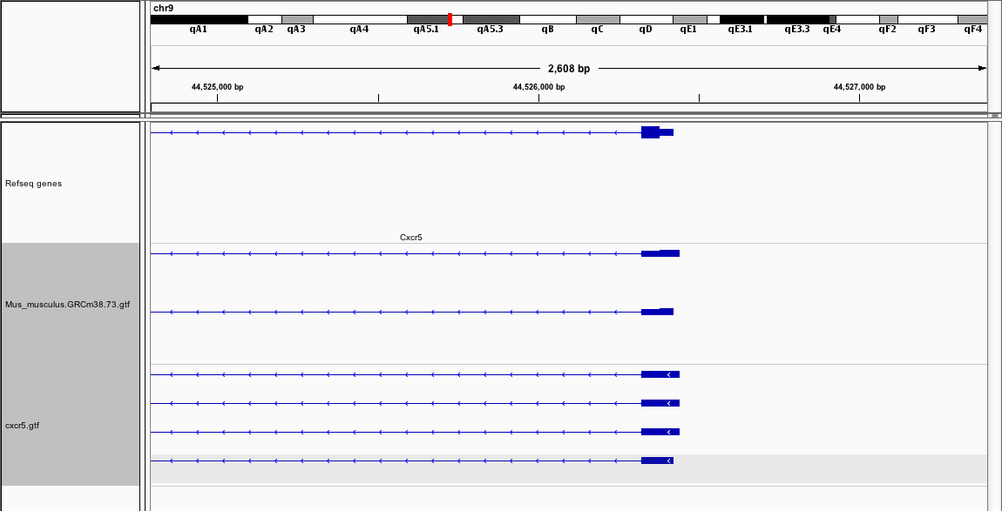
Cxcr5 – from cufflinks
Ensembl annotations
Cufflinks annotations
Cufflinks defined 4 isoforms, which can be correlated with the 2 official Ensembl isoforms based on the 3’ features
Cufflinks isoforms 1-3 are defined by their 5’ variations

Slide 28
Cxcr5 – from cufflinks
Cxcr5 is by adding cufflinks isoforms 1-4 together
Cxcr5-iso1 is by adding cufflinks isoforms 1-3 together
Cxcr5-iso2 is the cufflinks isoform 4

Slide 29
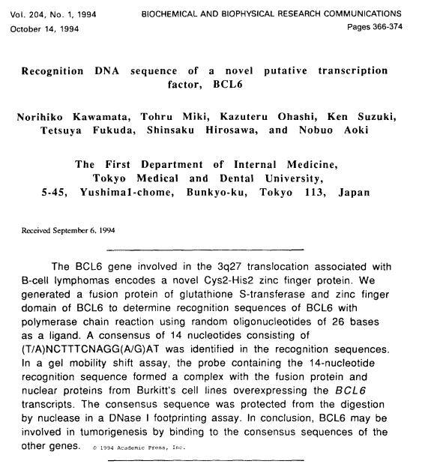
Bcl6 sites in JASPAR

Slide 30
Bcl6 sites in JASPAR

Slide 31
Bcl6 sites in JASPAR

Slide 32
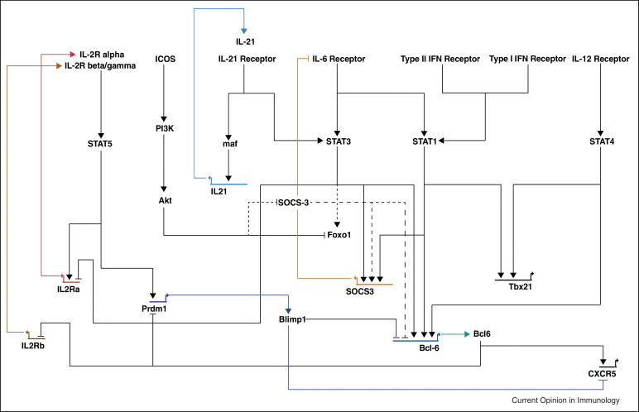
Pathway

Slide 33
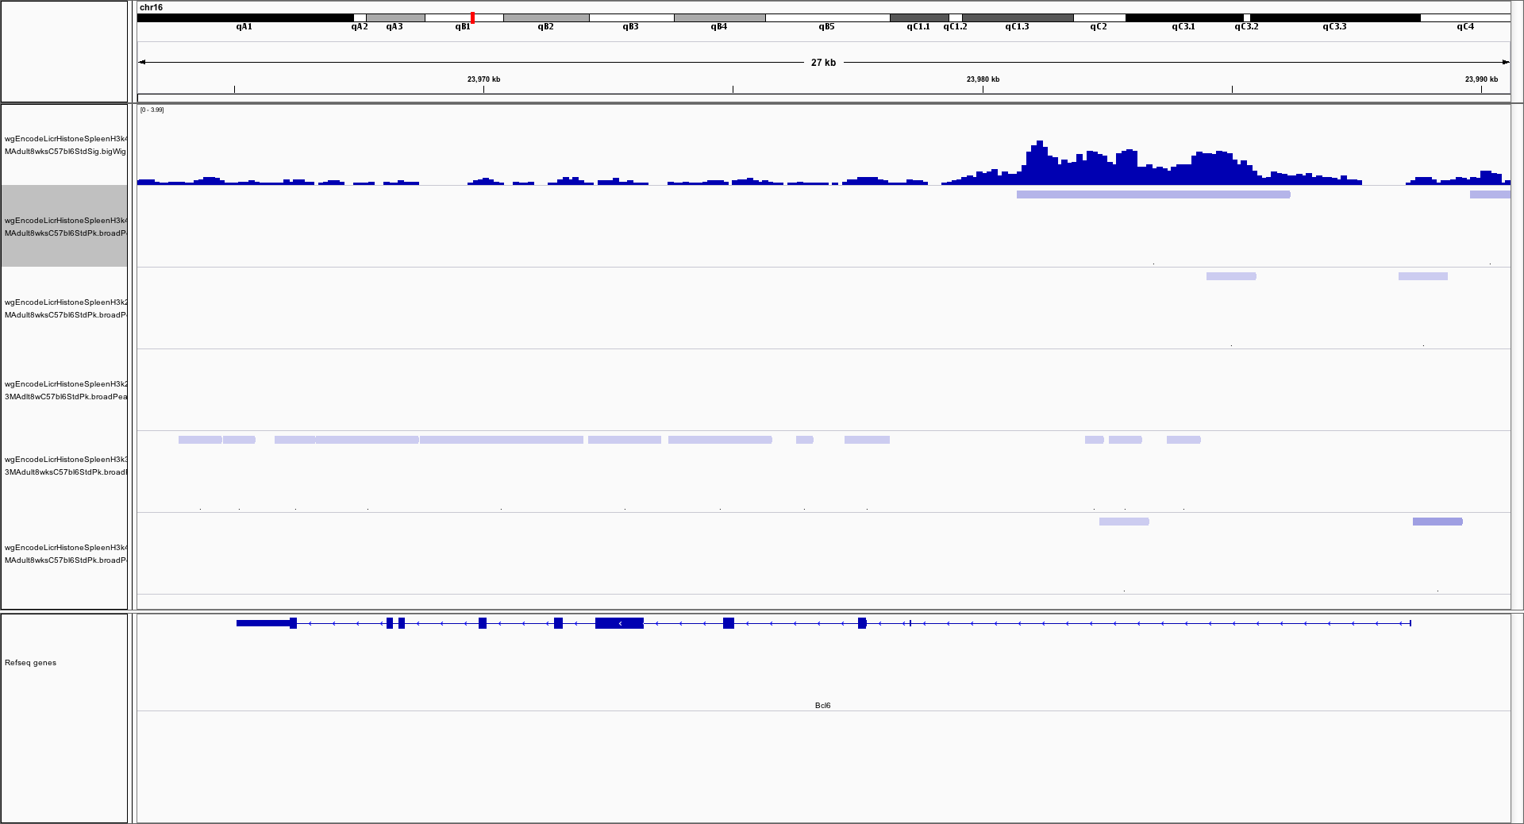
Mouse Encode Histones in Spleen
H3k4me1
H3k4me1
H3k4me3
H3k27me3
H3k27ac
H3k36me3

Slide 34
Mouse Encode Histones in Spleen
H3k4me1
H3k4me3
H3k27me3
H3k27ac
H3k36me3

Slide 35
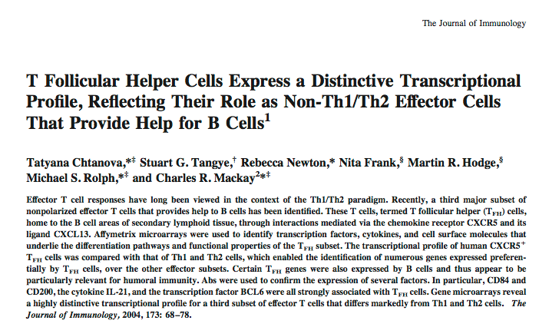
Human TFH

Slide 36
Human TFH
T Follicular Helper Cells Express a Distinctive Transcriptional Profile, Reflecting Their Role as Non-Th1/Th2 Effector Cells That Provide Help for B Cells
Journal of Immunology, 2004

Slide 37
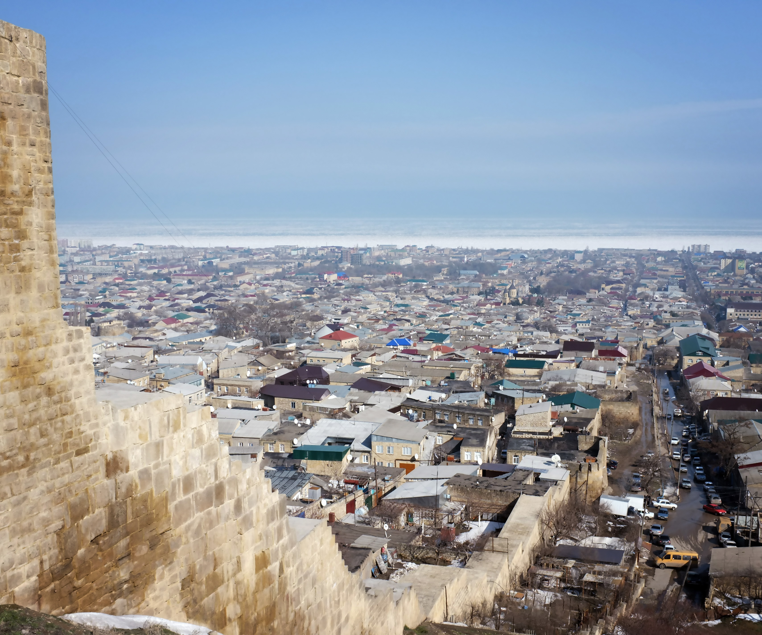
Thanks.

